Slide 1
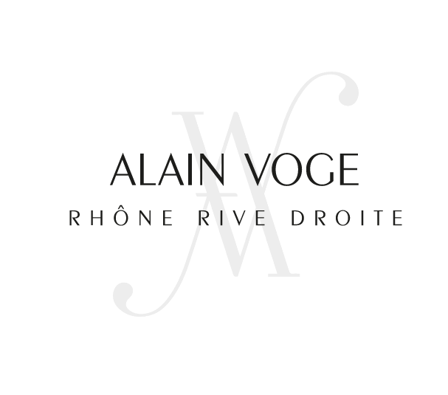

Slide 2
Alain Voge, 1939-2020, the heart at work
Alain Voge, founder of the eponymous estate in Cornas, passed away on Wednesday September 2, at the age of 81. Man of commitment, he was free and united. A visionary for his estate while being endowed with a powerful collective spirit for his region, he has dedicated his life to raising the Cornas and Saint-Péray appellations to the top of the Rhône Valley wine hierarchy. His years of rugby allied with solid convictions and strong human values had forged in him this defender of heritage, private and public.
Alain Voge will remain in our collective memory as a major historical figure of our vineyard.

Slide 3
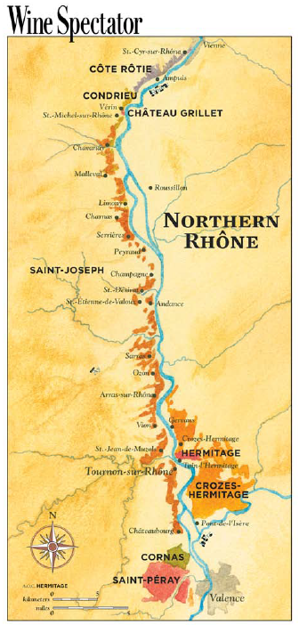

Slide 4
Domaine Alain Voge is an estate producer located in Cornas, France, dedicated to two varietals: Syrah and Marsanne.
This certified organic estate uses biodynamic techniques, with single vineyard locations in the Appellations of Cornas and St. Peray.
The Rhone river has formed absolutely stunning geographical features here.
Vines cling to steep slopes laid out in terraces, some of them with just a few rows of vines, and are planted facing South or East in soil mainly comprised
of granite, with some limestone.
The flagship wine, Cornas Les Vieilles Vignes is a cult classic, which is consistently one of the highest rated wines of the region.
The white wine appellation, Saint-Péray, has the unique 100% Marsanne,
from the old vine vineyard of Fleur De Crussol, which is rated among the top wines in the appellation. Alain Voge philosophy is to practice a hand made viticulture.

Slide 5
In 1905, Alain’s great-grandfather, Henri Voge, crossed the Rhone river to settle on its right bank. His grandfather and then his father took over the business, one after the other, each generation expanding the family’s agricultural activity. In 1961, Alain starts working alongside his father, who sadly dies suddenly at an early age in 1965. He takes on the management of the farm and the vines and begins to develop the sale of bottled wines.
In 1980, Alain Voge decides that he will concentrate his efforts solely as a winegrower. His work is a tremendous asset for the recognition of the
Cornas and Saint-Péray appellations.
Between 1979 and 2000, he begins a mammoth task of clearing and redeveloping the hillsides of Cornas; protecting the area of the Cornas appellation threatened by revision. He launches a new vineyard planted in the higher part of Cornas at an altitude of 380 meters and orders the construction of a new cellar.
He energizes his commitment to Saint Peray and makes the first Saint-Péray still wine vinified in barrels and revives the appellation with the Cuvée Boisée.

Slide 6
In 2004, the foundations of the domain are firmly established in the roots of Cornas and the brand name Alain Voge is solid. Its founder then decides once again to look towards the future.
The company SARL Alain Voge is founded with a managing director named Albéric Mazoyer, who is from the Ardèche region like Alain.
Upon selecting Laurent Martin as vineyard manager, Alberic begins to direct the conversion of the domain to 100% organic farming; starting first with the vineyards of Saint-Péray. Since 2016, the entire Alain Voge estate is certified for organic winegrowing.
In 2012, Lionel Fraisse, a native of Saint-Péray, nephew of Robert Fraisse, winegrower and close friend of Alain Voge, arrives at the domain to assist Albéric Mazoyer. They All share the same sensitivities about viticulture being in harmony with nature.
In 2018, Alain Voge asks Mr. Fraisse to take the lead as Managing Director, following the retirement of Albéric Mazoyer.

Slide 7
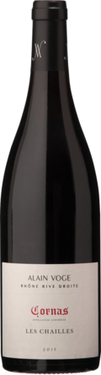
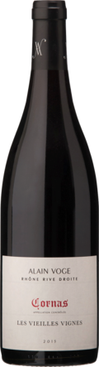
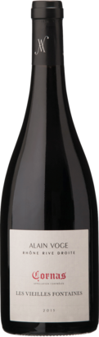
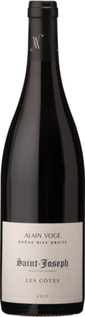
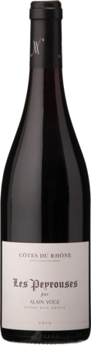
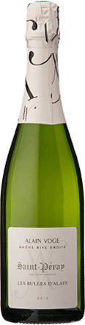
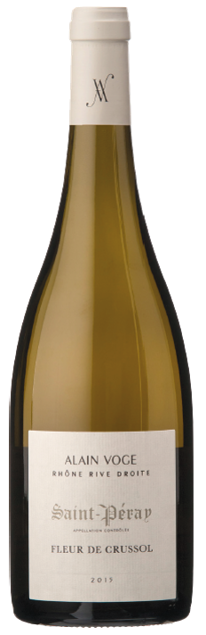
The Selection

Slide 8
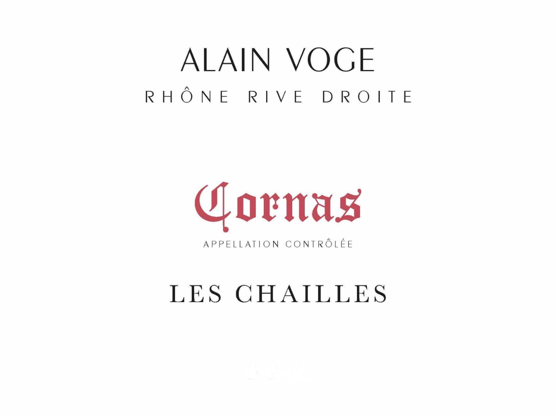

Slide 9
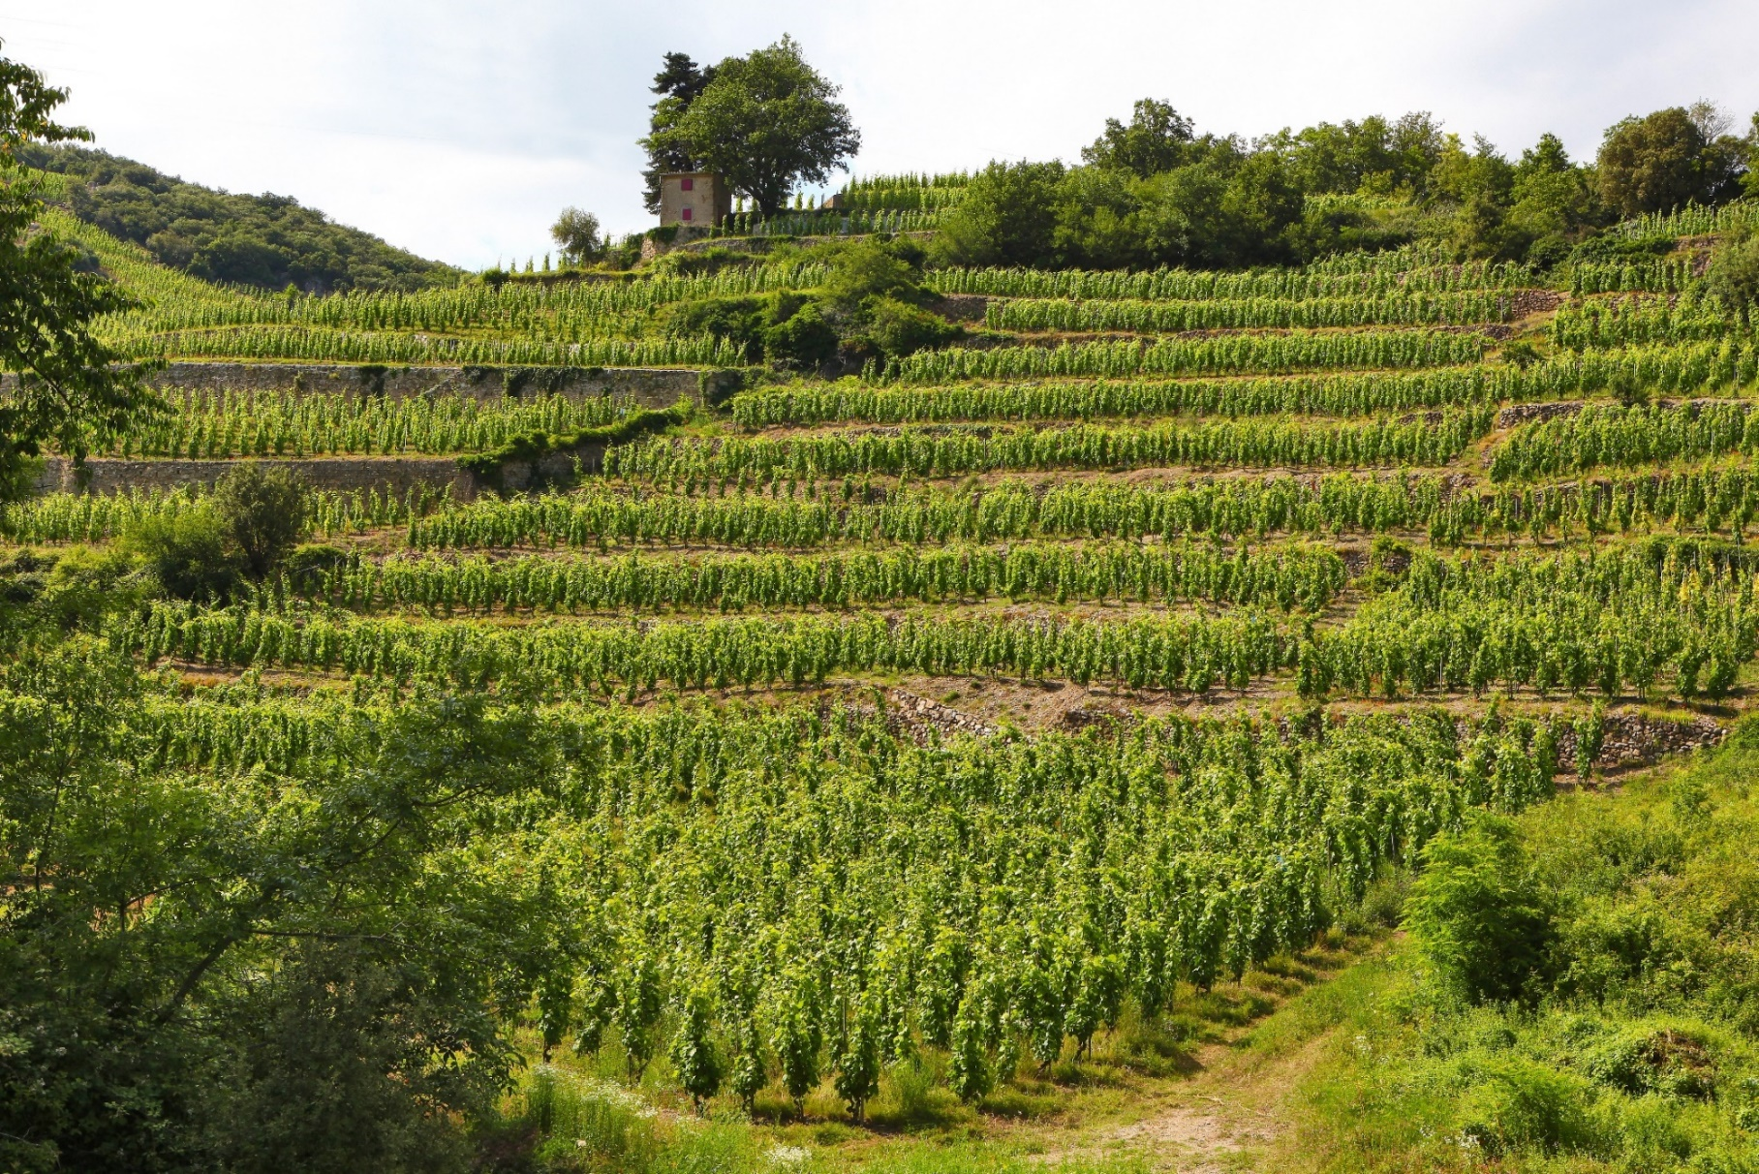
Made with a blend of grapes from the lower slopes of six specific sites, Les Chailles is an ideal starting point from which to discover the domain and the Syrah from Cornas. To reach a stage of plenitude, Les Chailles will require less years of ageing than our other Cornas wines.

Slide 10
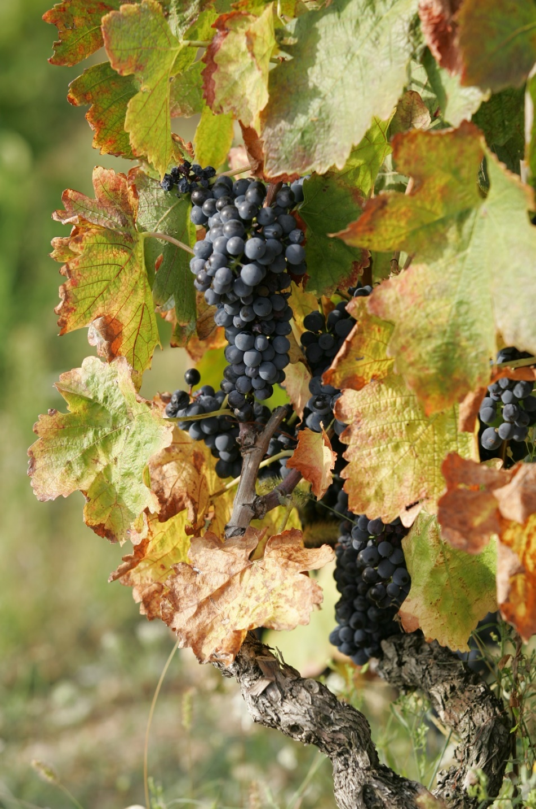
Syrah vines aged forty years. At the foot of granite slopes in Cornas, with soils more fertile here than in higher areas, bestowing the vine with vitality and producing slightly higher yields. Proximity to the limestone mountain range named Arlettes to the north explains the presence of siliceous concretions specific to the Trias area, called chailles. The majority of grapes are de-stemmed. Fermentation is with natural yeasts. Wines are matured in 228-litre barrels for 18 months, with no new oak.

Slide 11
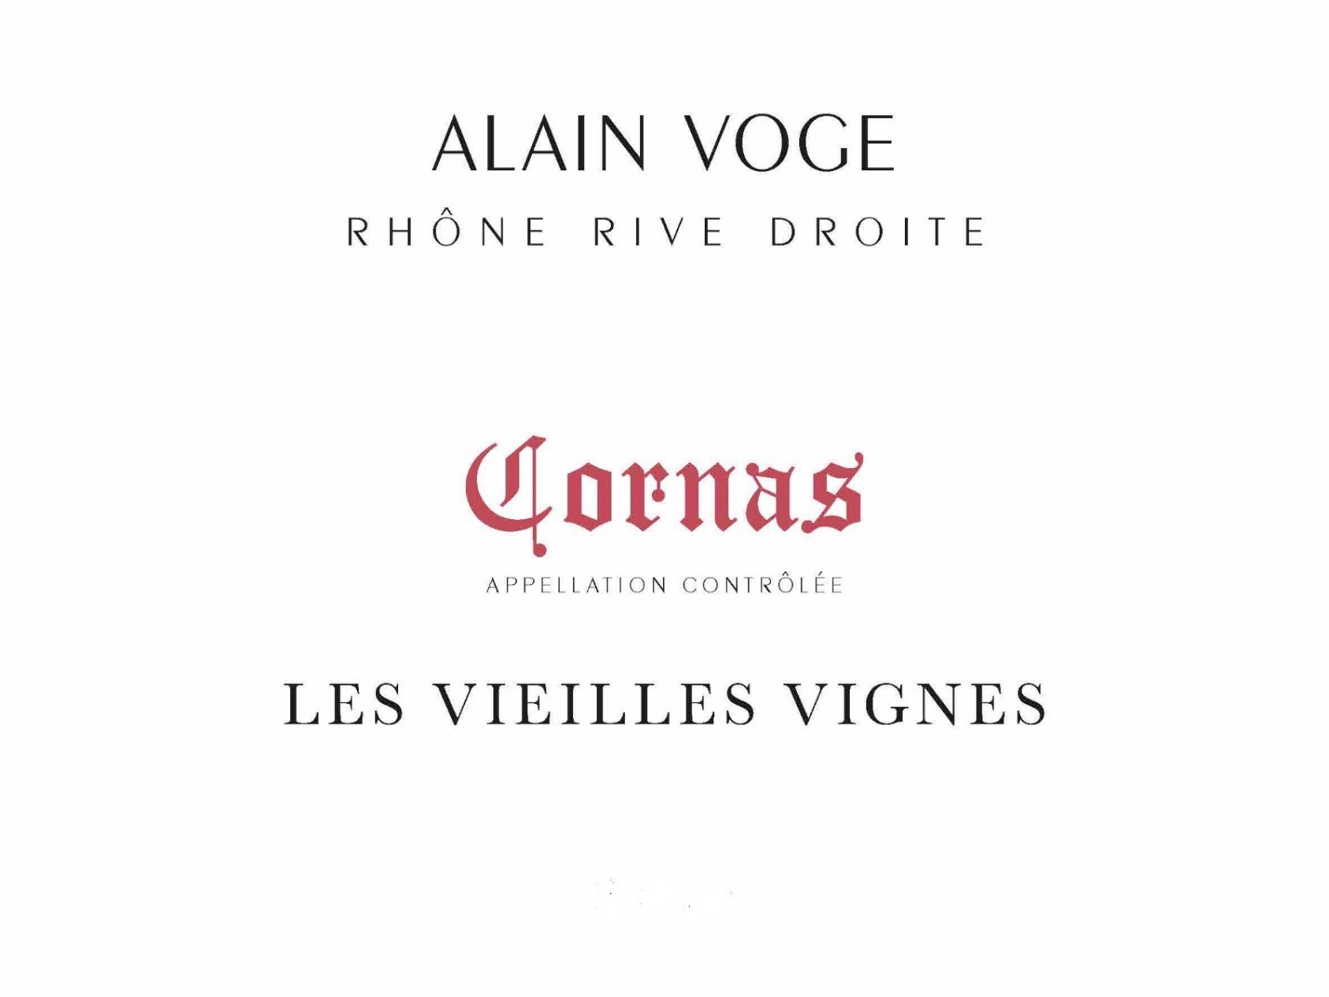

Slide 12
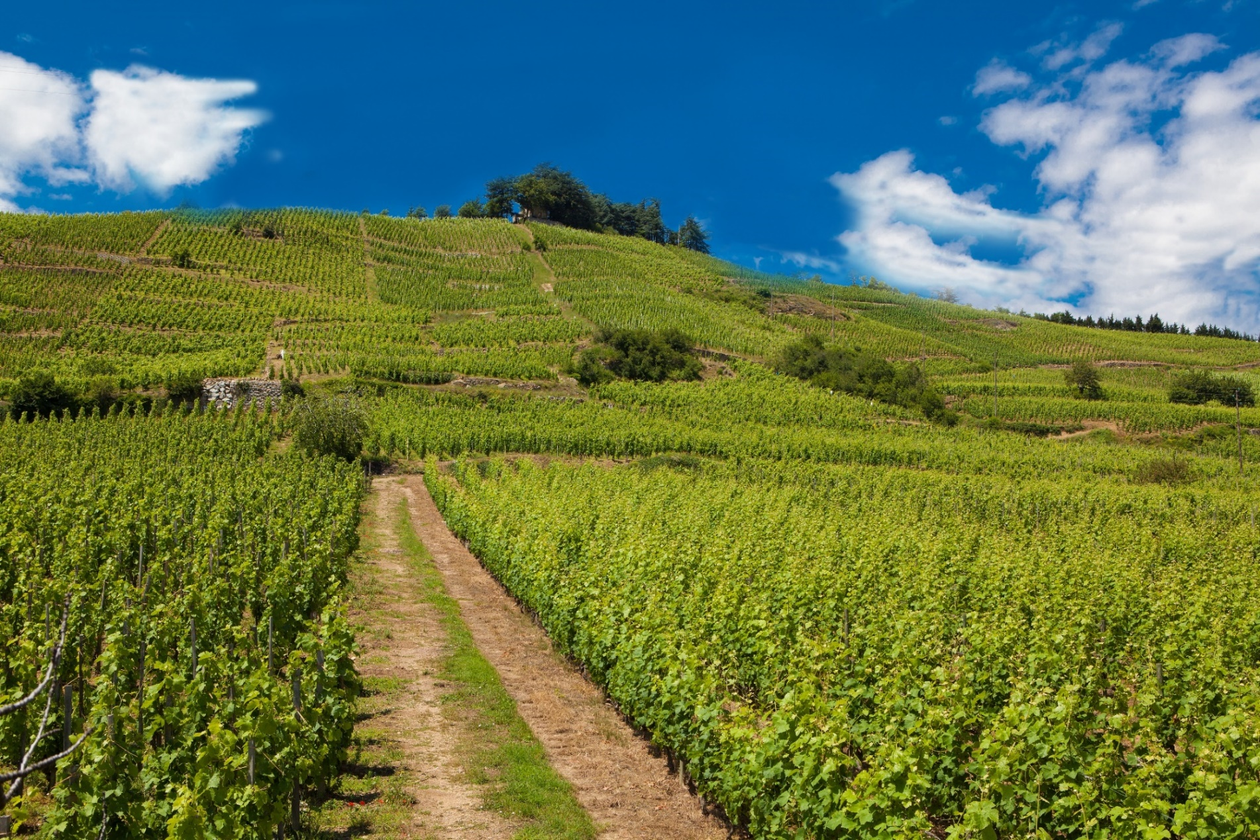
This is our classic wine. The oldest of the Domain’s wines, it was created during the 1970s to highlight the long-standing family vineyard. Vines are located in the heart of the appellation, from mid and upper slopes of the estate. Les Vieilles Vignes is a wine that showcases our history and our winemaking know-how.

Slide 13
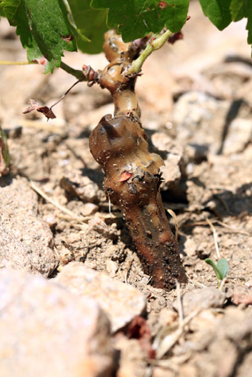
Situated on slopes at an altitude of approximately 200 metres, facing South-South-East, the vines of our Vieilles Vignes are on average 60 years old. Their roots delve deep down into old, worn granite rock, called gores locally.
Partial destemming with 20 % whole grapes, fermentation is with natural yeasts. The Vieilles Vignes is matured in 228-litre barrels for 20 months, with 15% new barrels.

Slide 14
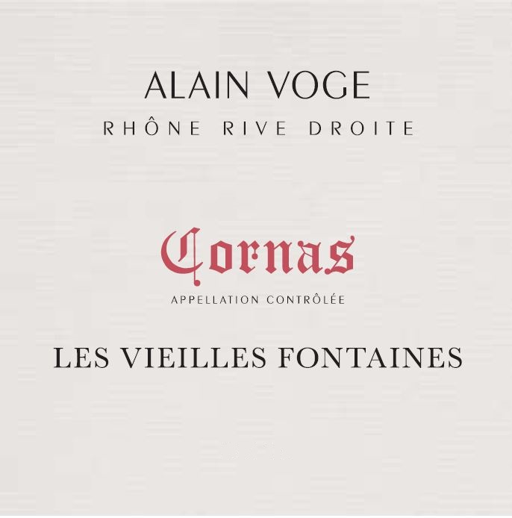

Slide 15
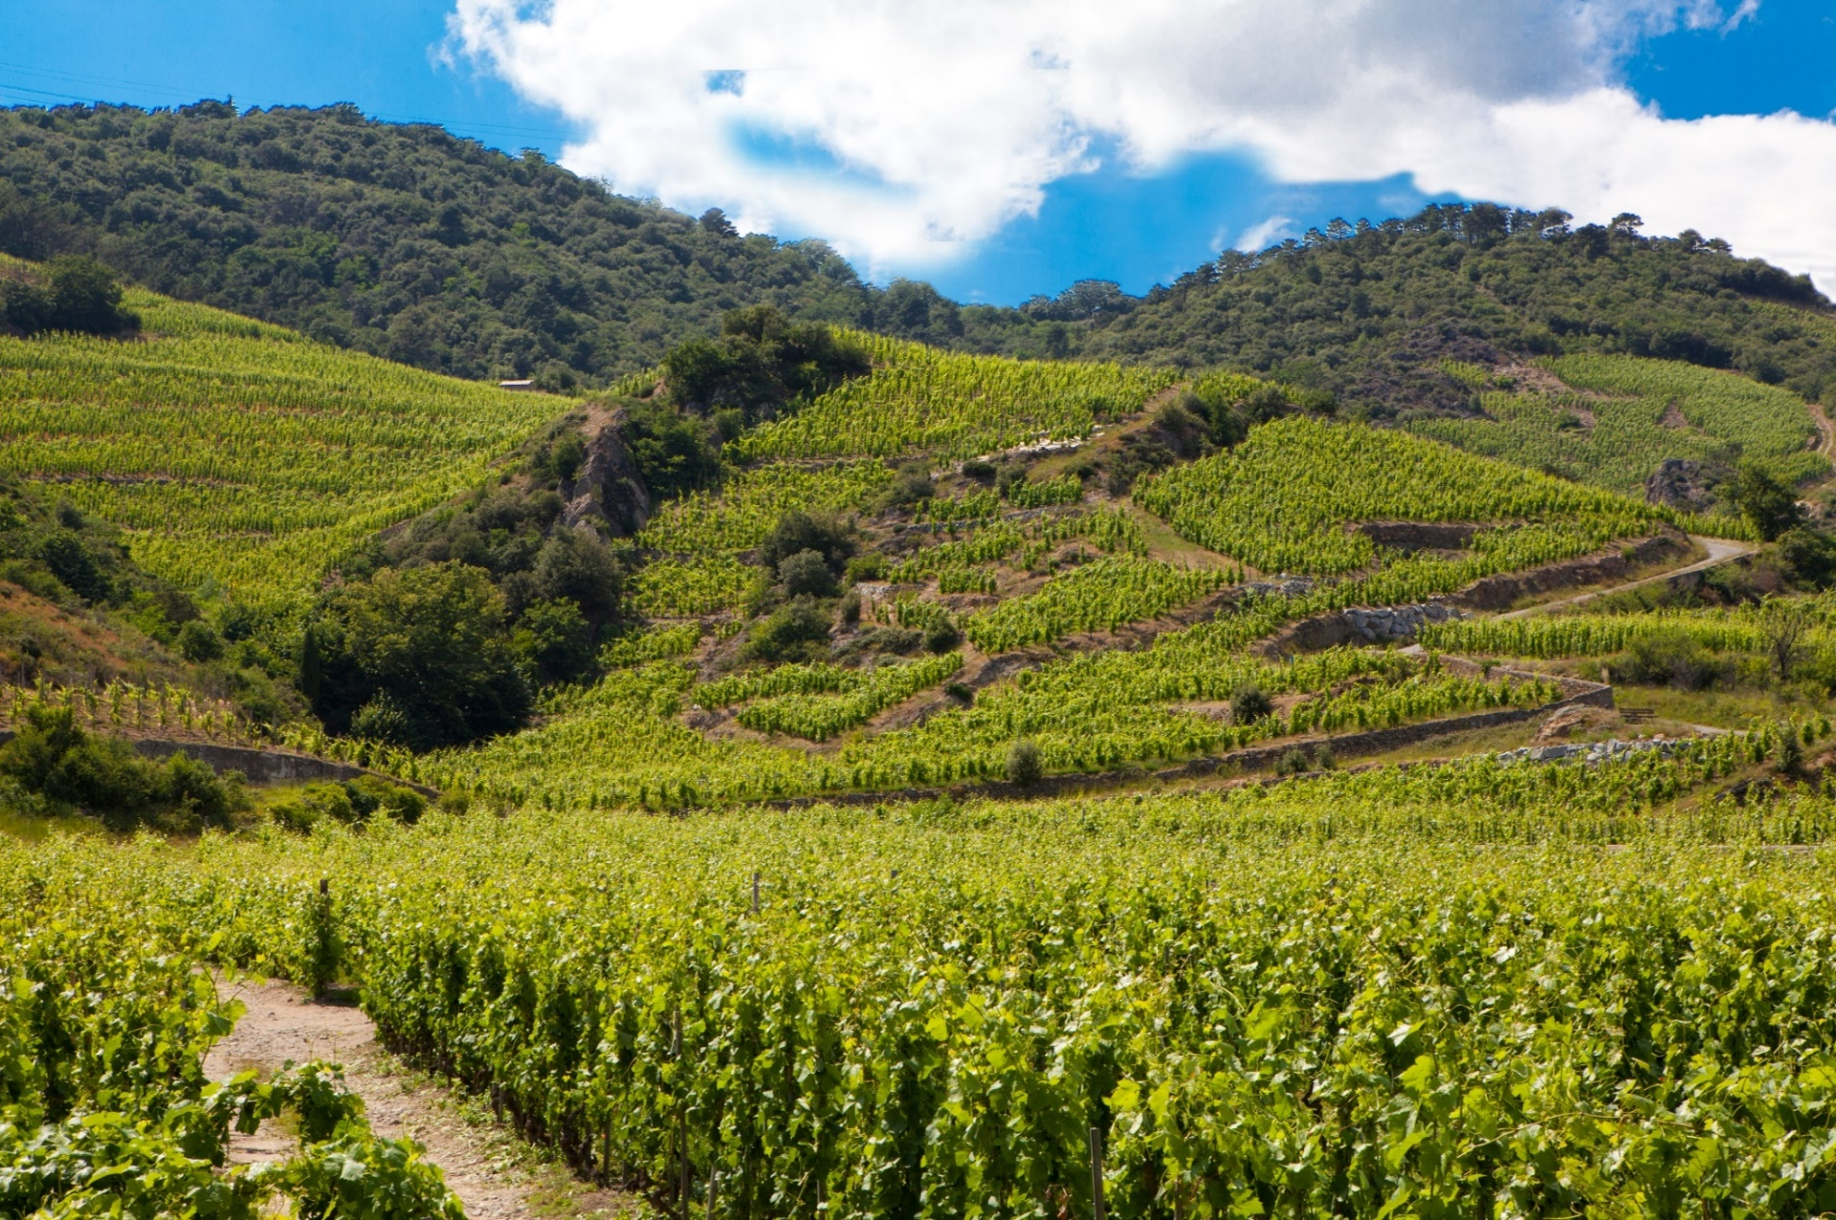
Produced solely in superb vintages, comes from this high elevation single parcel of .9 ha. The 85 plus year old vines are planted on magnificent granite terroir; with deep set roots that produce grapes of outstanding expression.

Slide 16
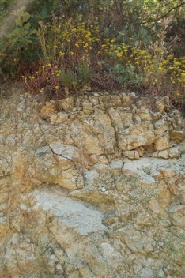
In the locality named “La Fontaine” is a spring that used to supply water to the home of a noble family in Cornas. The wine named Les Vieilles Fontaines was first made by Alain Voge in 1988 on this superb granite terroir, enhanced by our oldest Syrah vines. Partial destemming with 30 % whole grapes. Wines are matured in 228-litre barrels for a period of 24 months; 20% new oak barrels.

Slide 17
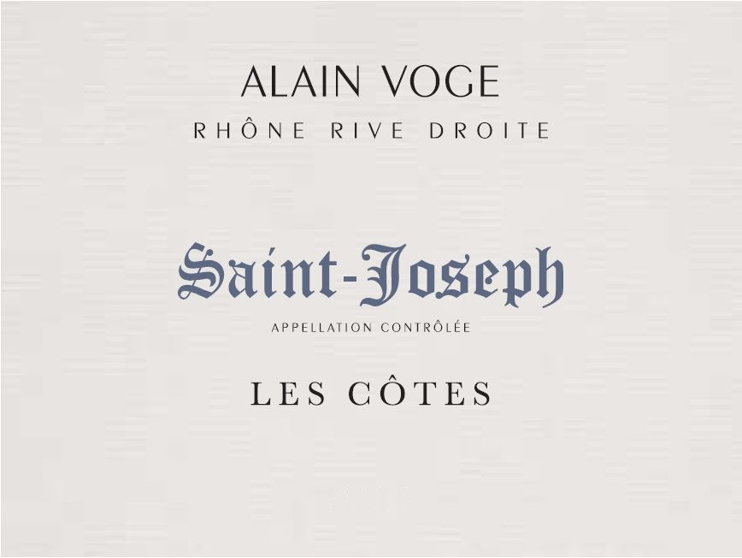

Slide 18
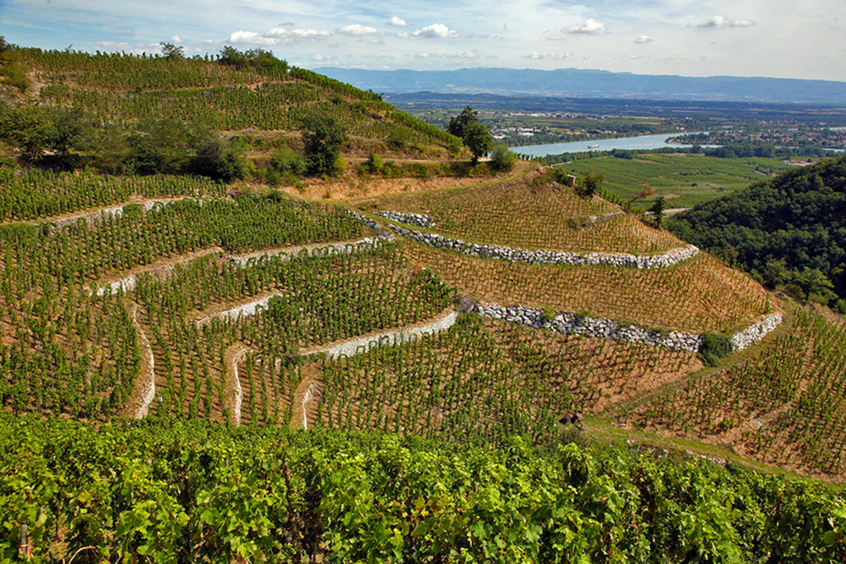
Alain Voge has produced Saint-Joseph wines for ten years. From the 2015 vintage, our Saint-Joseph takes the name of the locality where it is grown: Les Côtes, with Organic certification for the vines replanted from 1999.
The Single site of 1.1 ha. produces 2300 btls, year.

Slide 19
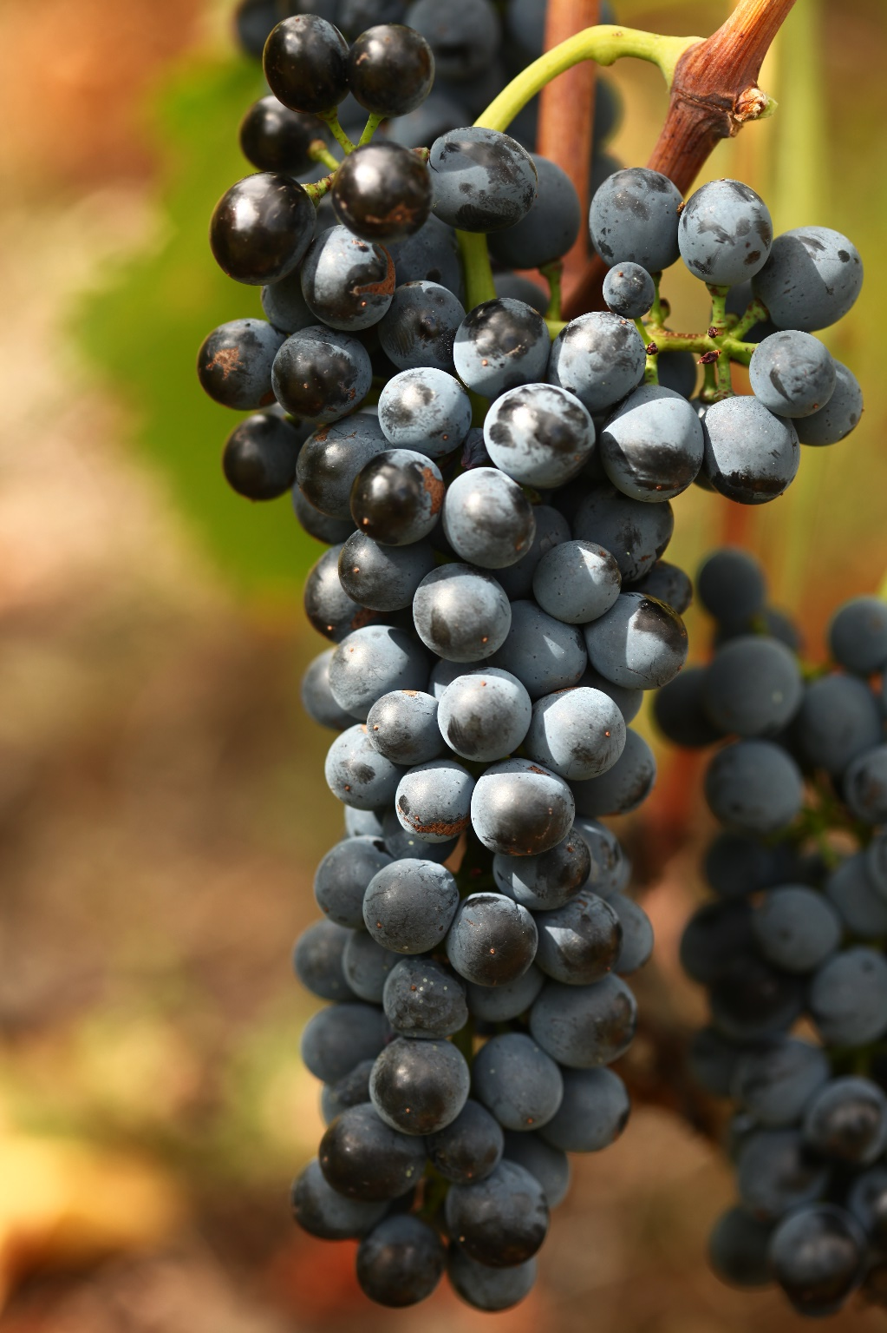
A very steep granite slope facing South in the “showcase slopes” of Mauves, to the South of the Saint-Joseph appellation. This terroir has enormous potential and it is gradually revealing its expression as the vines mature. The average age of the vines is 15 years.
10- 20% whole grape bunches, depending on the vintage. Wines are matured in 228-litre barrels for 16 months, with no new barrels.

Slide 20
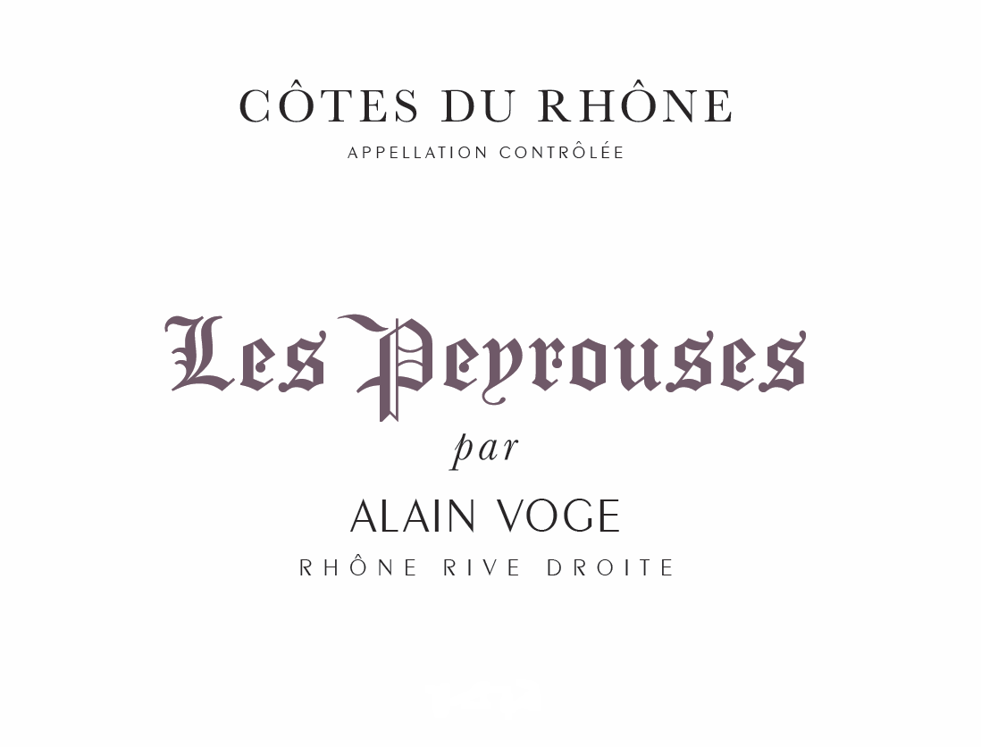

Slide 21
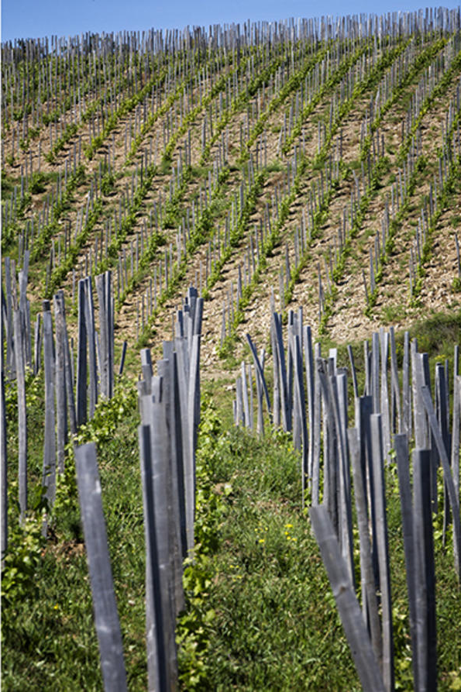
Les Peyrouses, Cotes Du Rhone, is with the purpose of ensuring very high standards to maintain superb quality for our Cornas wines, for our winemaking we handle separately grapes from our youngest vines or those that come from terroirs which are trickier in difficult years.
To the Domaine quantity that varies from one vintage to another, we add wine produced organically, which we buy from a terroir situated as close as possible to Cornas. It possesses the qualities of freshness we seek and will blend coherently with the wine that comes from our youngest vines. Wines are matured in older 228-litre barrels for 12 months.

Slide 22
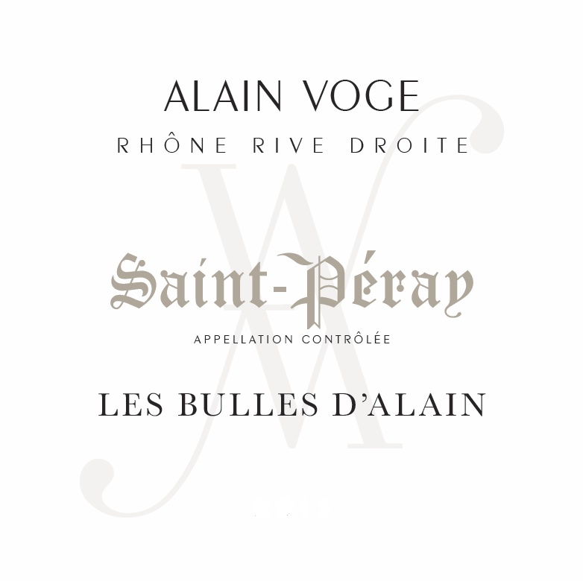

Slide 23
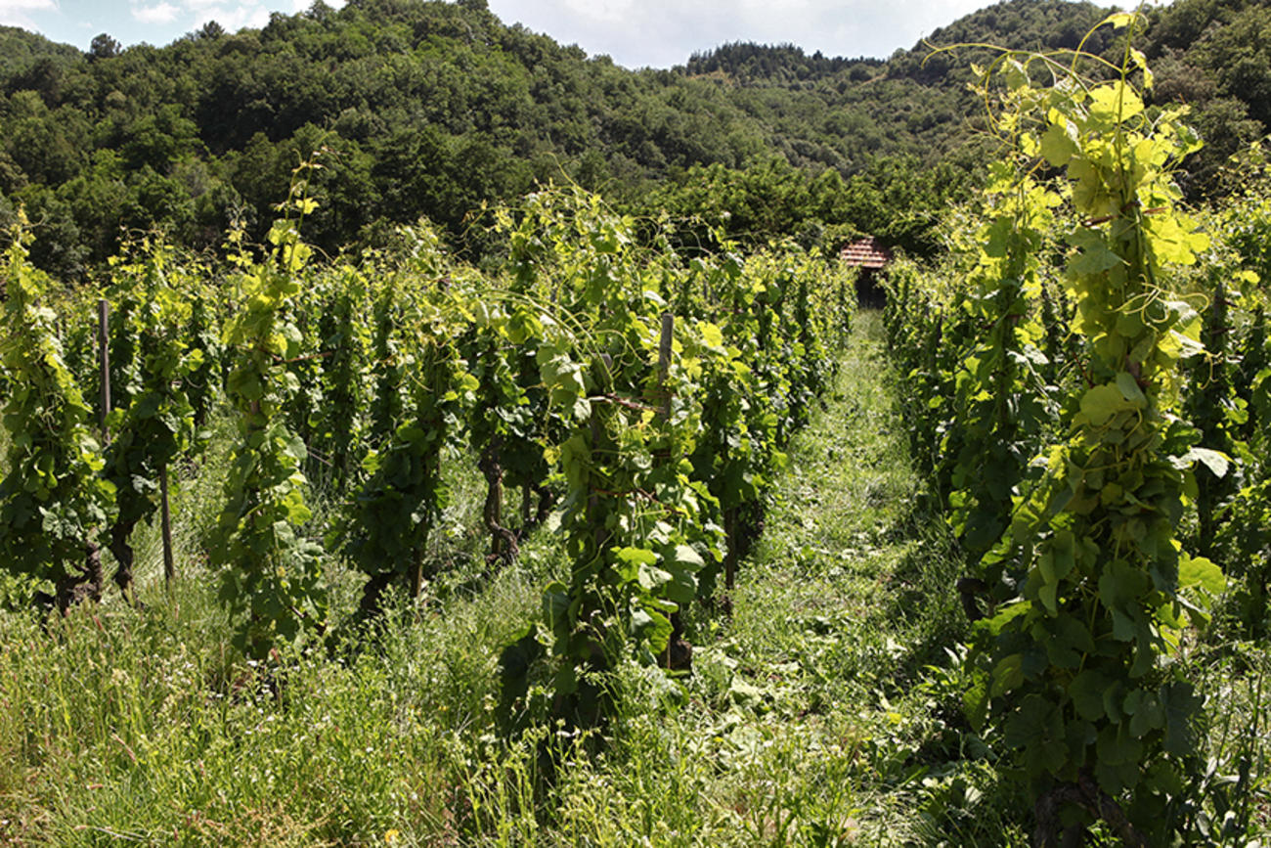
Alain Voge perpetuates Saint-Péray’s custom of making traditional method sparkling wine, the original basis and reputation of Saint-Péray; from two single sites of 100% Marsanne, trained and pruned in the Gobelet style.

Slide 24
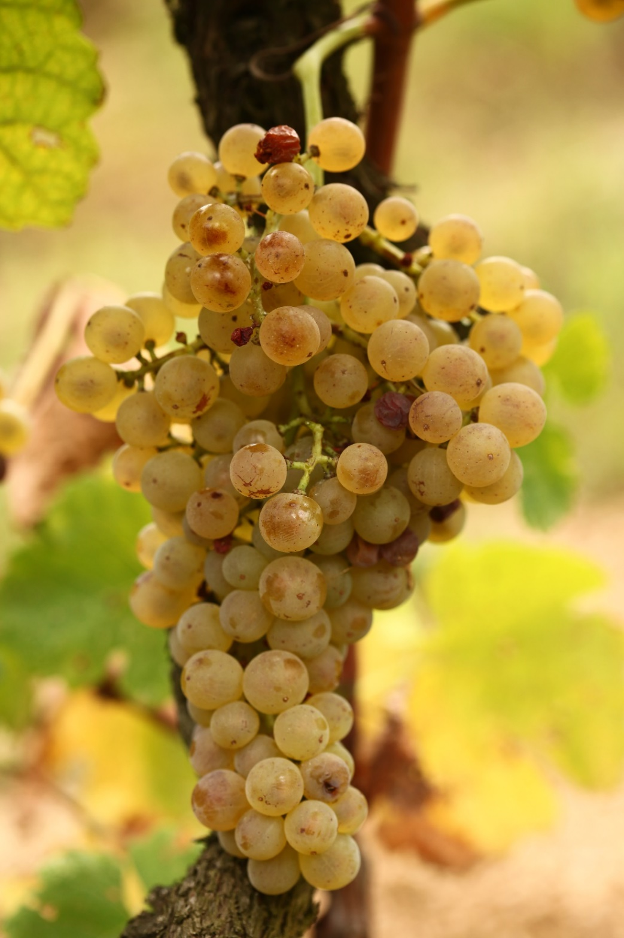
Approximately 30 years old, the vines are planted on granite colluvium enriched by some limestone (Grandes Blaches), and in the higher areas purely granite of the Saint-Péray appellation (Perrier). Sparkling wine made according to the traditional method: the base wine fermented at low temperature in small stainless steel and concrete vats. The second fermentation in bottle, is aged for a minimum
of 3 years, with no addition of dosage after disgorging.
Brut nature.

Slide 25
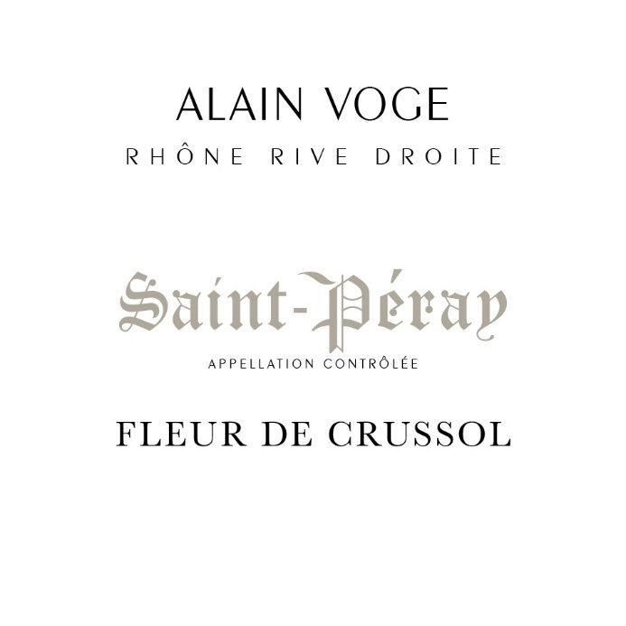

Slide 26
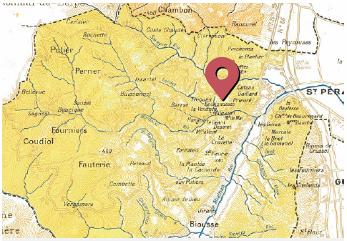
This wine was created in 1999 by Alain Voge with the friendly assistance of the late Daniel Denis, sommelier from the Lyon area and an expert representative of Rhone Valley wines. The Crussol mountain range, which gave its name to the wine, is extremely important for the Saint-Péray AOC, because it provides limestone elements essential for making fine white wines.

Slide 27

Situated in the place of origin of the appellation above the village of Saint-Péray and aged 80 years, the vines are the oldest of the domain and of the appellation. This slope of granite mixed with limestone colluvium faces South-East. It stands opposite Château de Crussol and the mountain range of the same name. Fermentation using natural yeasts, exclusively in 228-litre and 400-litre oak barrels, 30% of which are new oak. The wine is matured on lees for a period of 16 months.

Slide 28
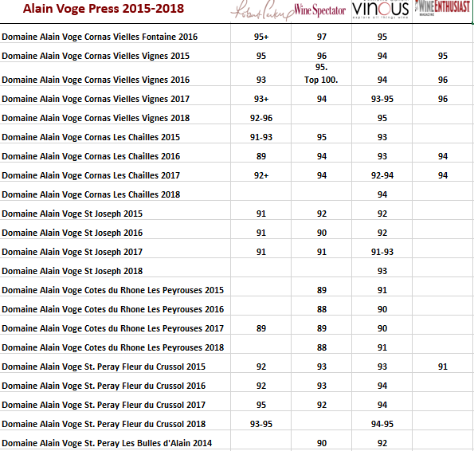

Slide 29
Pursuing the Values, Respect, Tradition and Rectitude.
An All-Out Quest guided by Passion.
Imported by Citadel Trading Corp.
New York, NY 10010
https://www.alain-voge.com/en/
Trade link. https://www.citadel-trading.com

